Slide 1



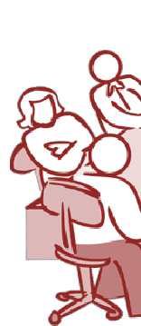
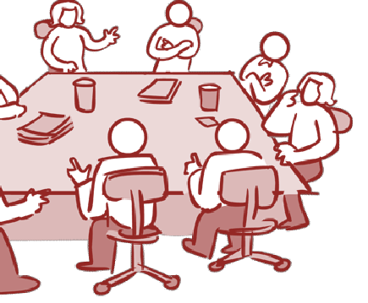








Software Requirement
Unit 2.4
Specification
Requirement Analysis & Specification

Slide 2
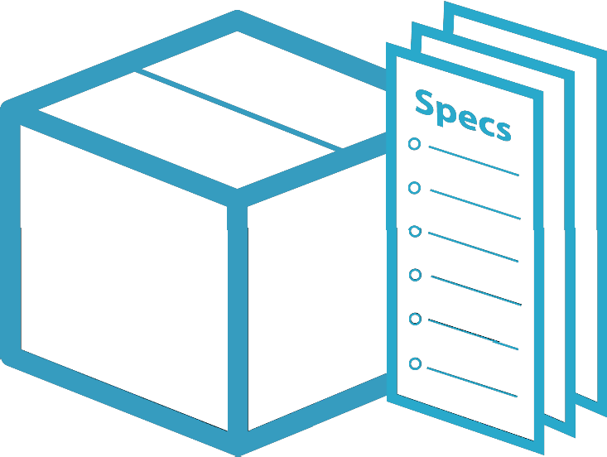
Requirements Engineering Tasks cont.
5
Specification
Create analysis model
It ay be written document, set of
gra hical
models, model,
formal collection of
p
r S
mathematical
use
scenarios, prototype or collection
of these
SR (Software Requirement
Specification) is a document that is cre ted when a detailed description of all aspects of software to build must be specified before starting of project

Slide 3
Software Requirements Specification
Software Requirement Specification (SRS is a document that completely describes what the prop)osed software should do without describing how software will do it.
It contains:
•
•
•
•
•
•
a complete information description a detailed functional description
a representation of system behaviour
an indication of performance requirements and design constraints
appropriate validation criteria
other information suitable to r quirements
◻ SRS is also helping the clients t understand their own needs.
o

Slide 4
Characteristics of a Good SRS
SRS should be accurate, complete, efficient, and of high quality
so that it does not affect the entire project plan.
An SRS is said to be of high quality when the developer and user easily understand the prepared document.
Characteristics of a Good SRS:
Correct
SRS is correct when all user
requirements are stated in the
requirements document.
Note that there is no specified tool or procedure to assure the correctness of SRS.
Unambiguous
SRS is unambiguous when every stated requirement has only one interpretation.

Slide 5
Characteristics of a Good SRS (Cont…)
Complete
SRS is complete when the requirements clearly define what the software is required to do.
Ranked for Importance/Stabili y
Al requirements are not
equally important, hence make differences among
each other
_{l}requirement is identified to
requirements.
Stability implies the probability of changes in the requirement in future.
Modifiable
•
The requirements of the user can change, hence requirements
document should be created in such a manner that those changes
can be modified easily.
Traceable
•
SRS is traceable when the source of each requirement is clear and facilitates the reference of ea h requirement in future.
c

Slide 6
Characteristics of a Good SRS (Cont…)
Verifiable
SRS is verifiable when the specified requirements can be verified with a cost-effective process to check whether the final software meets those requirements.
Consistent
SRS is consistent when the subsets of individual requirements defined do not conflict with each other.

Slide 7
Standard Template for writing SRS
Front Page
Software Requirements Specification for
<Project> Version
<no.> Prepared by
<author>
<organization>
<date created>
Table of Contents
Revision History

Slide 8
Standard Template for
w
riting SRS(Cont…)
Introduction
Purpose
Document Conventions
Intended Audience and Reading Suggestions
Project Scope
References
Overall Description
Product Perspective
Product Features
User Classes and Characteristics
Operating Environment
Design and Implementation Constraints

Slide 9
Standard Template for riting SRS(Cont…)
w
User Documentation
Assumptions and Dependencies
System Features
System Feature 1
System Feature 2 (and so on)
External Interface Requirements
User Interfaces
Hardware Interfaces
Software Interfaces
Communications Interfaces

Slide 10
Standard Template for riting SRS(Cont…)
w
Other Nonfunctional Requirements
Performance Requirements
Safety Requirements
Security Requirements
Software Quality Attributes
Other Requirements
Appendix A: Glossary Appendix B: Analysis Appendix Models
C: Issues Li t

Slide 11
Problems Without SRS
Without developing the SRS d cument, the system would not be properly implemented according to customer needs.
Software developers would n t know whether what they are developing is what exactly is re uired by the customer.
Without SRS, it will be very difficult for the maintenance engineers to understand the functionality of the system.
It will be very difficult for user document writers to write the users’ manuals properly without understanding the SRS.
o
o

Slide 12
Summary
◻ Requirements Engineering ◻ Requirements Analysis Model
Requirements Engineering Tasks
Eliciting Requirements
Collaborative Requirements Gathering
Quality Function Deployment
Usage Scenarios
Elicitation Work Products
Use-Case Diagram
Class Diagram
State Diagram
Data Flow
Diagram
Negotiating Requirements
Functional and non-functional requirements
SRS

Slide 13

Requirements Engineering Tasks cont.
6
Validation
Ensure quality of requirements
Review the requirements specification for
errors, ambiguities, omissions (absence) and conflicts
Validation. The work products produced as a consequence of requirements engineering are assessed for quality during a validation step. Requirements validation examines the specification to ensur
that all software requirements have been stated unambiguously;
that inconsistencies, omissions, and errors have been detected and corrected;
that the work products conform to the standards established for the process, the project, and the product

Slide 14

Requirements Engineering Tasks
7
Requirements Management
It is a s t of activities to identify, control & trace requirements & changes to require ents (Umbrella Activities) at any time as the project proceeds.
Requirements management is the pro ess of collecting, analyzing, refining, and prioritizing product requirements and then planning for their delivery. Big Word Requirement Change Management and relationship of change in requirement (Impact).
Requirements management does not end with product release. From that point on, the data coming in about the applicatio ’s acceptability is gathered and fed into the Investigation phase of the next generation or release. Thus the process begins again.
m
c
n

Slide 15



Requirements Analysis is Hard
“The seeds of major software disasters are usually sown in the first three months of commencing the software project.”
“The hardest single part of building a software system is
deciding what to build. No part of the work so cripples the resulting system if done wrong.”
"Fred" Brooks Jr. is an American computer architect,
software engineer, and
Capers Jones is an
American specialist in software engineering methodologies
computer scientist, best k own for managing the development of IBM's System/360 family of
n
computers

